Slide 1
Predict Helpful Reviews
ALI RIFAT KAYA

Slide 2
Table of Contents
The Research Question
EDA (particularly on the restaurant businesses)
Data Cleaning & Feature Extraction
Predictive Results
Conclusion

Slide 3

Why Helpful Reviews?
An outcome of a customer’s experience with a product and an input for a potential customer’s buying process.
The potential buyers need to reach the most helpful customer reviews with minimum time and effort to use their resources more efficiently
Help firms establish profitable business relationships by increasing the likelihood of purchase, providing material information about the product, or improving customer service.

Slide 4

The Dataset
Yelp academic dataset is available for free and open to the public.
business.json contains information about each company such as name and location, attributes, working hours, etc.
review.json has information about each posted review such as user id, star rating, the customer review itself, number of useful votes, etc.
user.json provides information about each Yelp user such as first name, the total number of reviews, the list of friends, the average star rating, etc.
checkin.json has information about check-in for each business, such as business id and date.
tip.json (the shorter version of reviews and conveys quick suggestions to the businesses) such as the tip itself, the number of compliments and dates, etc.
photo.json contains information about each photo uploaded to Yelp, such as photo id and photo label, etc.
* It can be acquired from Yelp's official website by filling a form indicating that the it will only be used for academic and research purposes.

Slide 5
The Dataset
8,021,122 reviews
1,968,703 users
209,393 businesses
3.74 star rating
22.17 reviews
36.9 reviews
1.323 helpful vote
39.8 helpful vote
30.5% restaurants

Slide 6
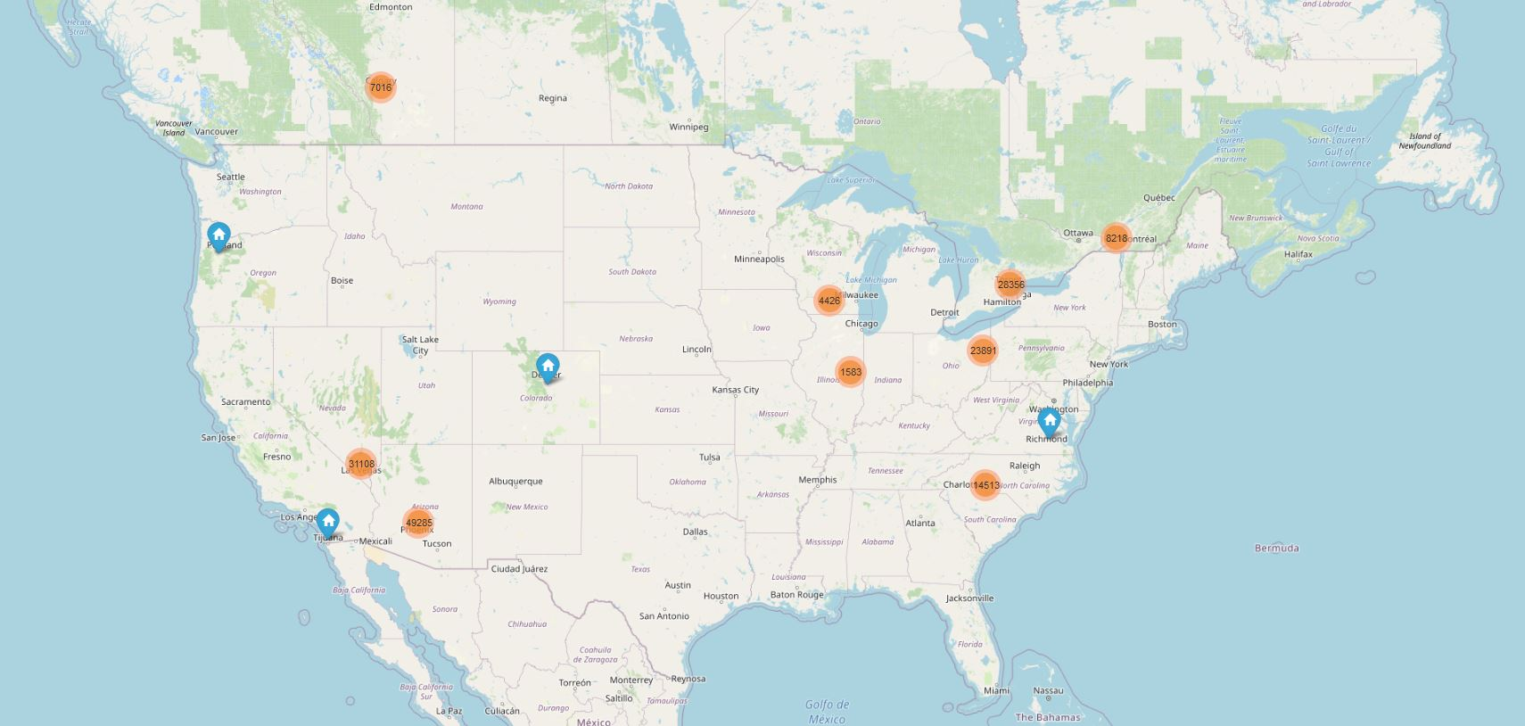
The Dataset

Slide 7
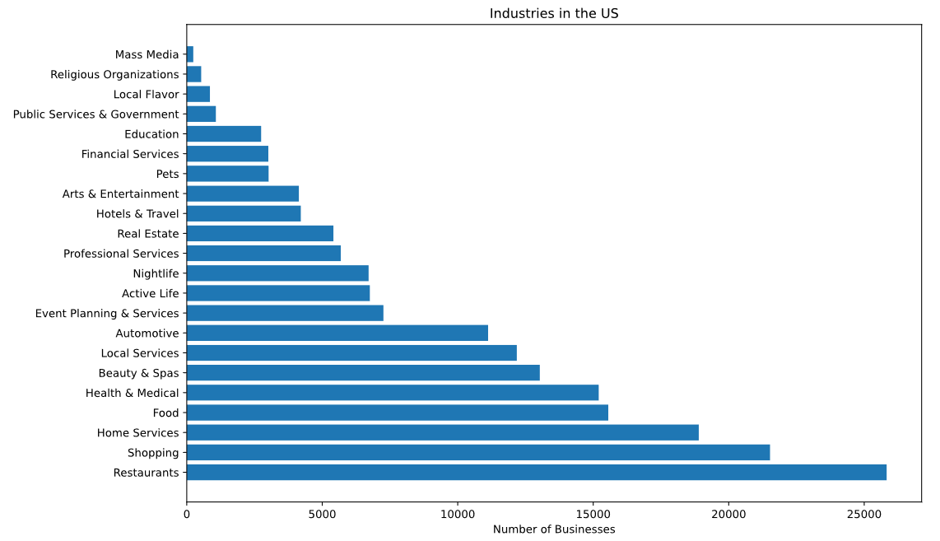
The Dataset

Slide 8
The Dataset
Business | Number of Branches
Subway Restaurants | 609
McDonald's | 536
Taco Bell | 294
Burger King | 273
Wendy's | 232
Pizza Hut | 232
Jack in the Box | 182
Chipotle Mexican Grill | 168
Jimmy John’s | 157
Panda Express | 145
25,827 restaurants
130.41 (average) reviews
10,129 (max) reviews
3,487,937 reviews
1.046 (average) helpful vote
758 (max) helpful vote

Slide 9
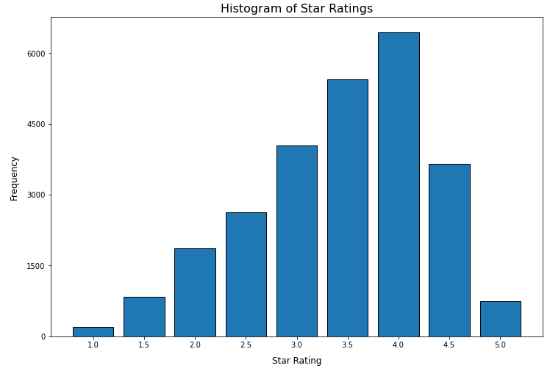
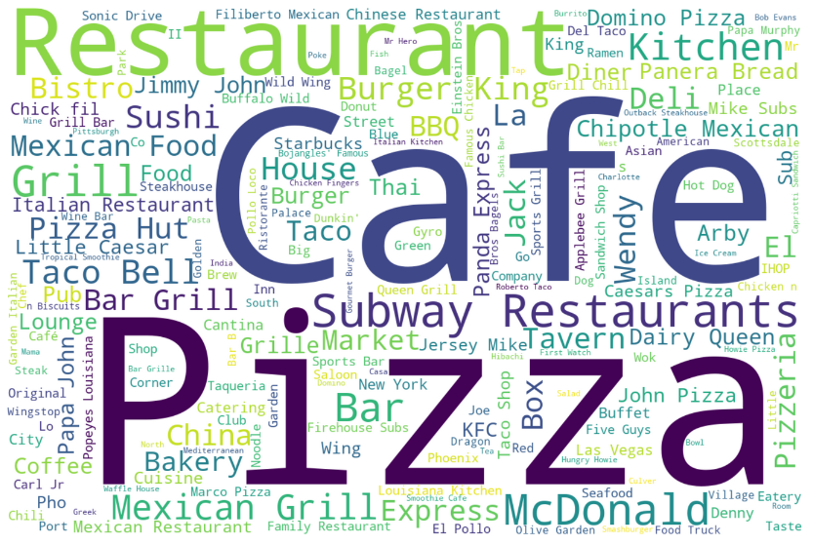
The Dataset

Slide 10
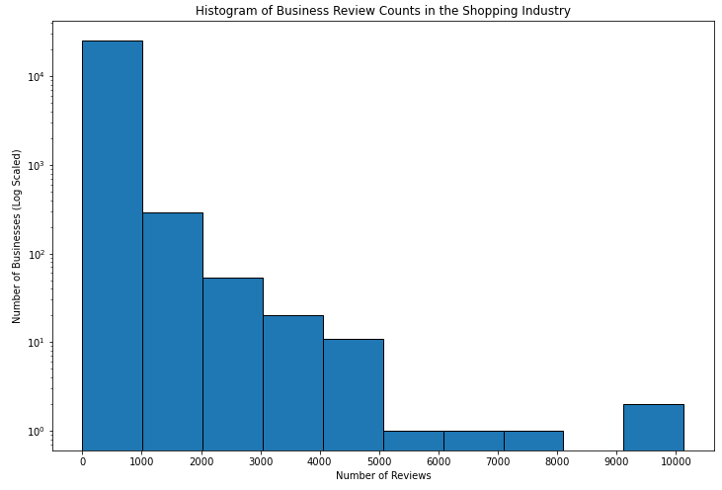
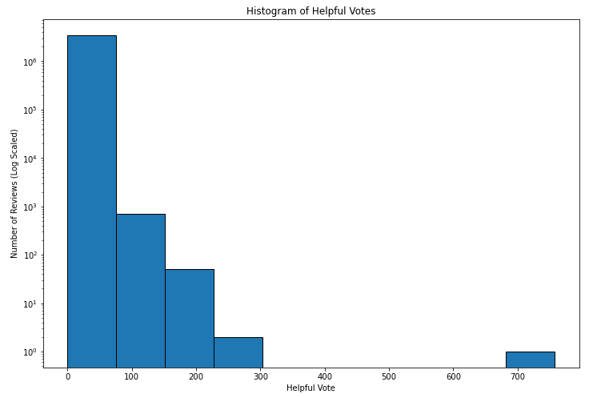
The Dataset

Slide 11
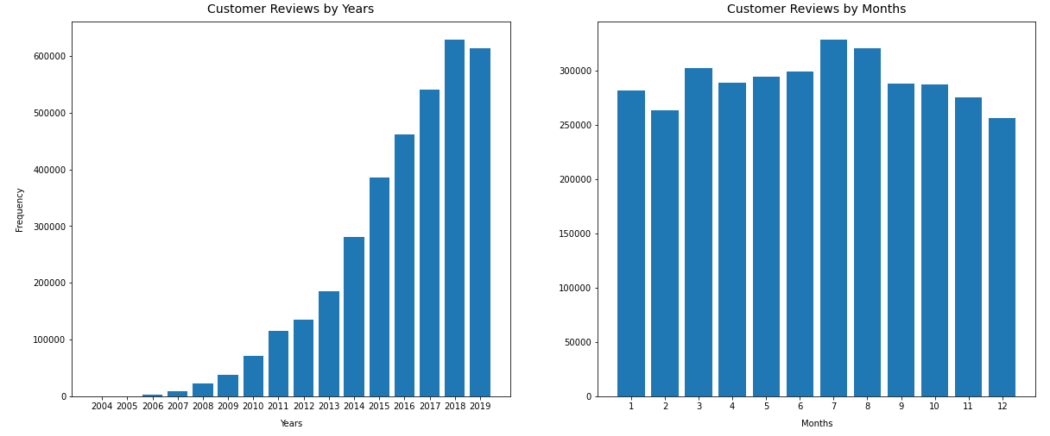
The Dataset

Slide 12
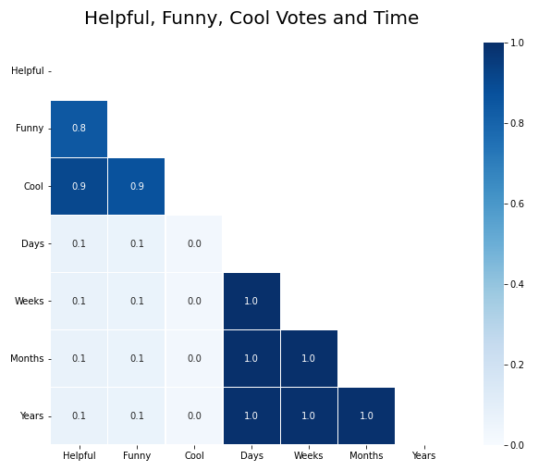
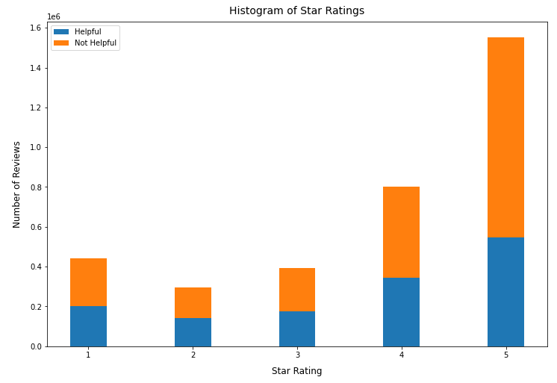
The Dataset

Slide 13
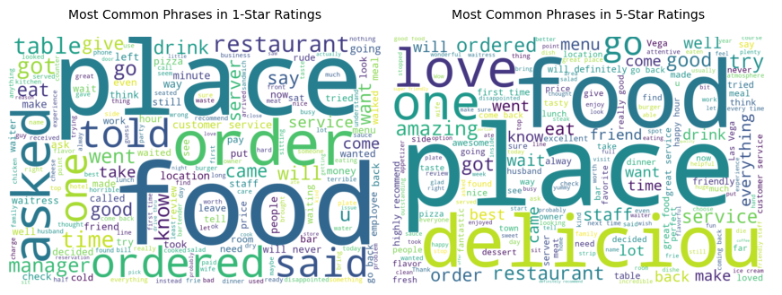
The Dataset

Slide 14
The Dataset
Name | Member Since | How Many Times Elite? | Average Star Rating | Number of Fans | Number of Reviews
Brad | 2009 | 0 | 3.11 | 77 | 1259
Stefany | 2011 | 7 | 3.39 | 785 | 1166
Michael | 2008 | 7 | 3.90 | 1090 | 915
Karen | 2006 | 6 | 3.88 | 479 | 832
Norm | 2008 | 9 | 3.75 | 319 | 815
Jennifer | 2010 | 7 | 3.61 | 98 | 810
Jennifer | 2009 | 9 | 4.05 | 185 | 682
Deni | 2010 | 5 | 3.62 | 154 | 639
Pepper | 2011 | 0 | 3.35 | 110 | 626
DJ | 2010 | 2 | 3.65 | 121 | 599

Slide 15
The Dataset
Business | City | State | Average Star Rating | Number of Reviews
Bacchanal Buffet | Las Vegas | NV | 4.0 | 10,417
Mon Ami Gabi | Las Vegas | NV | 4.0 | 9,536
Wicked Spoon | Las Vegas | NV | 3.5 | 7,594
Hash House A Go Go | Las Vegas | NV | 4.0 | 6,859
Earl of Sandwich | Las Vegas | NV | 4.5 | 5,370
Yardbird Southern Table & Bar | Las Vegas | NV | 4.5 | 4,979
The Cosmopolitan of Las Vegas | Las Vegas | NV | 4.0 | 4,973
The Buffet At Wynn | Las Vegas | NV | 3.5 | 4,953
Secret Pizza | Las Vegas | NV | 4.0 | 4,882
Luxor Hotel and Casino Las Vegas | Las Vegas | NV | 2.5 | 4,819

Slide 16
Data Cleaning & Feature Extraction
Basic features for EDA and predictive purposes
Number of Sentences
Number of Words
Number of Unique Words
Number of Punctuations
Number of Exclamation Marks
Number of Digits
Number of Dollar Sign
Number of Stop Words
Number of Uppercase Words
Number of Titlecase Words
Number of Letters
Average Word Length

Slide 17
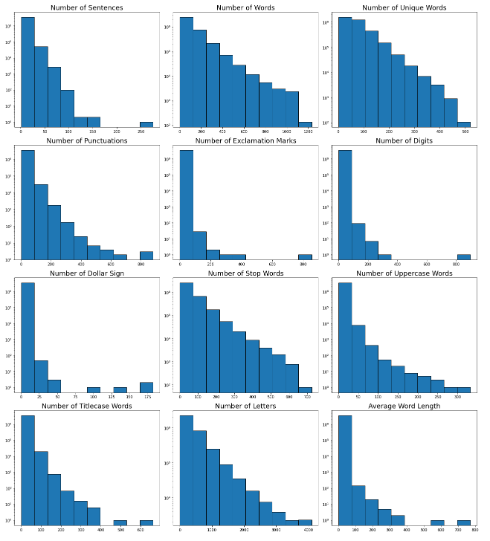
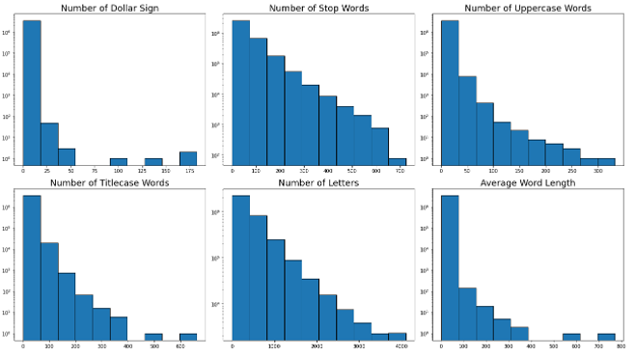
Data Cleaning & Feature Extraction

Slide 18
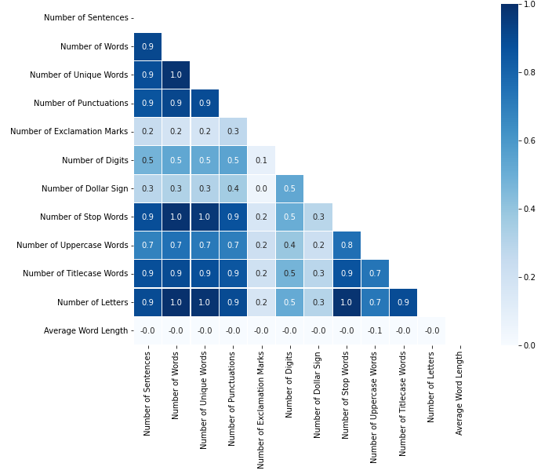
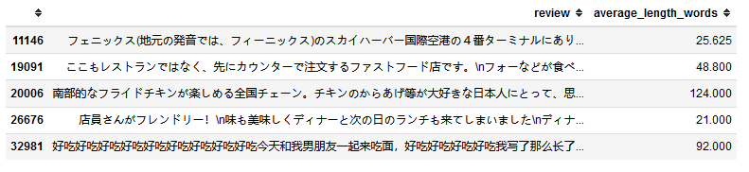
Data Cleaning & Feature Extraction
Feature | Correlation with Helpful Votes
Number of Sentences | 0.266259
Number of Words | 0.281358
Number of Unique Words | 0.287694
Number of Punctuations | 0.280379
Number of Exclamation Marks | 0.066640
Number of Digits | 0.164860
Number of Dollar Sign | 0.123075
Number of Stop Words | 0.261895
Number of Uppercase Words | 0.207940
Number of Titlecase Words | 0.294231
Number of Letters | 0.282718
Average Word Length | -0.018440

Slide 19
Data Cleaning & Feature Extraction
Feature extraction for predictive modelling
Number of Photos
Number of URLs
Number of Price
Number of Time
Number of Emoticons
Feature | Pearson R | Significance
PHOTO | 0.07 | 0.00
URL | 0.05 | 0.00
PRICE | 0.13 | 0.00
TIME | 0.07 | 0.00
EMOTICON | 0.16 | 0.00

Slide 20
Data Cleaning & Feature Extraction
Data Cleaning Steps
Replace Chinese and Japanese characters with whitespace
Whitespace formatting
Reduce duplicated letters (Ex. Sooooooooooooooooo → So)
Replace spaced words (Ex. A M A Z I N G → AMAZING)
Fix contractions (Ex. I’m → I am)
Remove hashtags (#) and mentions (@)
Remove punctuations
Remove digits
Lowercase terms
Remove stop words
Lemmatize and
Stemmer

Slide 21
Data Cleaning & Feature Extraction
Term | Frequency | Term | Frequency
food | 535,503 | love | 195,117
good | 455,635 | wait | 194,598
place | 437,241 | restaur | 193,228
great | 383,019 | eat | 187,496
time | 314,294 | friend | 182,940
order | 312,467 | amaz | 152,153
servic | 308,846 | delici | 150,732
make | 228,983 | nice | 148,213
back | 218,896 | tabl | 140,939
vega | 196,308 | drink | 138,937

Slide 22
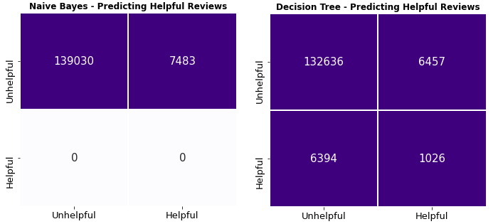
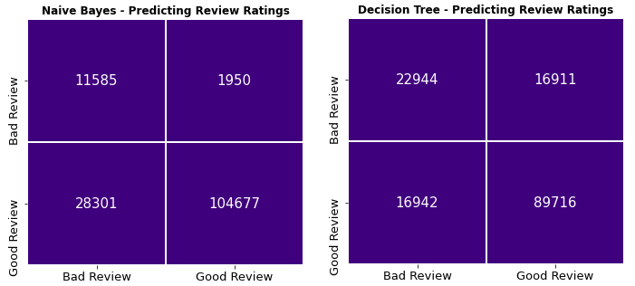
Predictive Modelling
TF-IDF matrix can predict star rating but not helpful votes
Change the Features and give it another try ☺

Slide 23
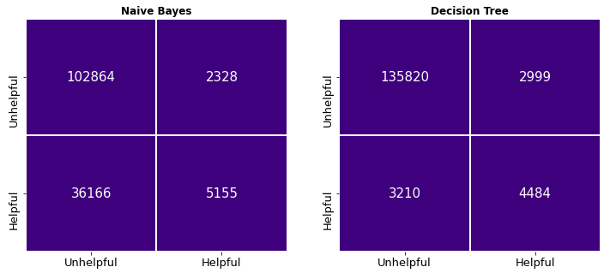
Predictive Modelling
Model performances improved significantly after using extracted features not the TF-IDF matrix

Slide 24
Predictive Modelling
 | Matthews CC | ROC Score | PR Score
Logistic Regression | 0.620788 | 0.974573 | 0.723073
KNN Classifier | 0.709184 | 0.989005 | 0.845982
Decision Tree Classifier | 0.999946 | 1.000000 | 1.000000
Random Forest Classifier | 0.999750 | 1.000000 | 1.000000
Extra Trees Classifier | 0.999946 | 1.000000 | 1.000000
XGBoost Classifier | 0.703560 | 0.983709 | 0.813996
Some algorithms are prone to overfitting
Let’s look at the confusion matrices
 | Matthews CC | ROC Score | PR Score
Logistic Regression | 0.638187 | 0.975003 | 0.727144
KNN Classifier | 0.625358 | 0.903029 | 0.677878
Decision Tree Classifier | 0.568085 | 0.789368 | 0.600847
Random Forest Classifier | 0.674447 | 0.970229 | 0.757467
Extra Trees Classifier | 0.640015 | 0.964758 | 0.724107
XGBoost Classifier | 0.684751 | 0.980687 | 0.785370

Slide 25
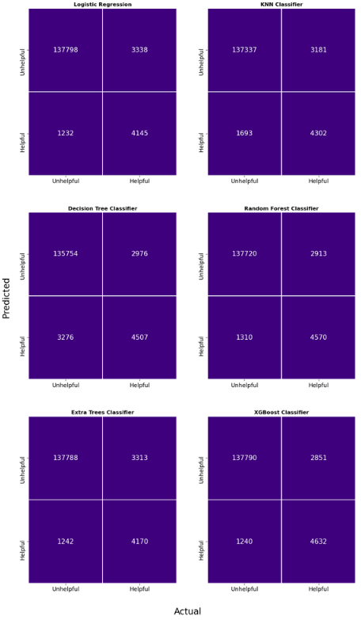
Predictive Modelling
According to the test scores and the confusion matrices, we can say that the best algorithm for detecting helpful reviews is XGBoost, which has the lowest False Positive and False Negative and the highest True Positive scores.

Slide 26
Predictive Modelling
 | Score (Default Parameters) | Score (Optimized Parameters) | Change
Logistic Regression | 0.975 | 0.976 | + 0.001
KNN Classifier | 0.897 | 0.950 | + 0.053
Decision Tree Classifier | 0.785 | 0.785 | 0.000
Random Forest Classifier | 0.969 | 0.976 | + 0.007
Extra Trees Classifier | 0.965 | 0.972 | + 0.007
XGBoost Classifier | 0.980 | 0.981 | + 0.001

Slide 27
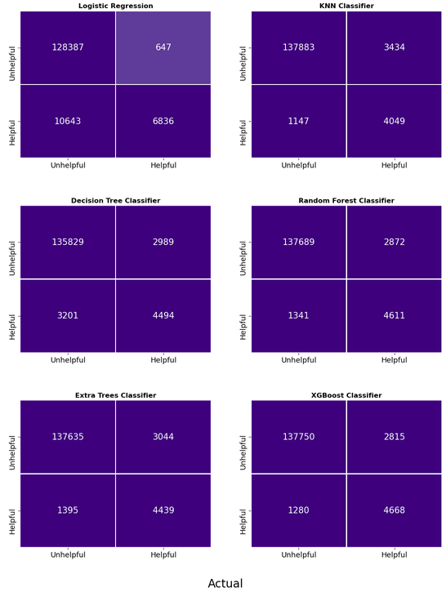
Predictive Modelling

Slide 28
Predictive Modelling
In the confusion matrices, we see that:
Logistic Regression predicted the highest number of helpful reviews at the expense of false positives. Moreover, it has the lowest number of false negatives among the algorithms.
KNN predicted an average number of helpful reviews with the lowest false positive rate. However, it has the most significant number of false negatives.
All other algorithms stay in the spectrum where the edges are Logistic Regression and KNN algorithms.

Slide 29
Predictive Modelling
 | Recall Rate | Predicted Value |  | True Value
Logistic Regression | 71.98 % | 4,853 | out of | 6,742
KNN Classifier | 95.16 % | 904 | out of | 950
Decision Tree Classifier | 58.40 % | 4,497 | out of | 7,700
Random Forest Classifier | 96.86 % | 924 | out of | 954
Extra Trees Classifier | 95.65 % | 593 | out of | 620
XGBoost Classifier | 97.91 % | 656 | out of | 670

Slide 30
Predictive Modelling
 | Recall Rate | Predicted Value |  | True Value
Logistic Regression | 100.00 % | 11 | out of | 11
KNN Classifier | 100.00 % | 11 | out of | 11
Decision Tree Classifier | 100.00 % | 11 | out of | 11
Random Forest Classifier | 72.73 % | 8 | out of | 11
Extra Trees Classifier | 81.82 % | 9 | out of | 11
XGBoost Classifier | 72.73 % | 8 | out of | 11

Slide 31
Predictive Modelling
Based on the algorithms' performance in the confusion matrices and the top 5% predicted reviews, we can say that KNN is the most practical algorithm. Even though XGBoost has the best performing results, it has some flaws:
KNN hits a 100% recall rate for the top 10 helpful reviews, but XGBoost stays at 72.73%.
Even though KNN has a lower recall rate in general, it has the most significant number of correctly predicted helpful reviews.
KNN provides a broader pool of helpful reviews for the business owner to hand-pick if necessary.
For those reasons, we believe that KNN is the best algorithm for our purpose in this project. We will provide some examples in the next chapters.

Slide 32
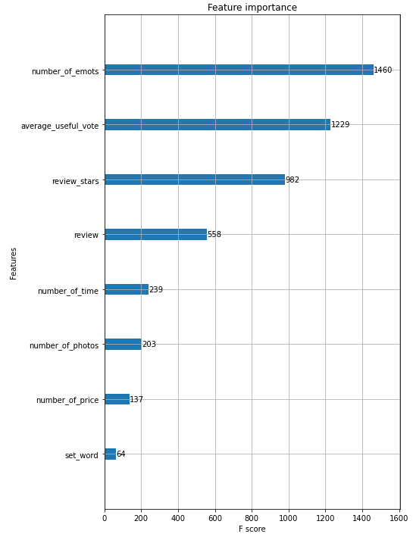
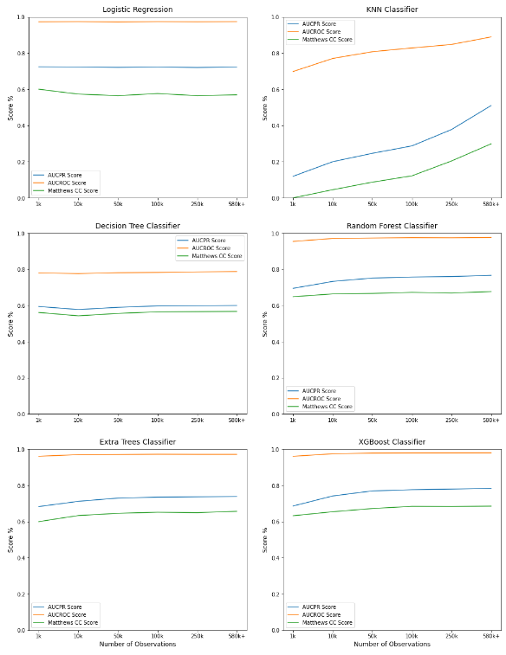
Predictive Modelling
Number of Emoticons is the most important features to decide if a review is a helpful review
KNN shows the most significant improvement as it fed with more data

